Slide 1

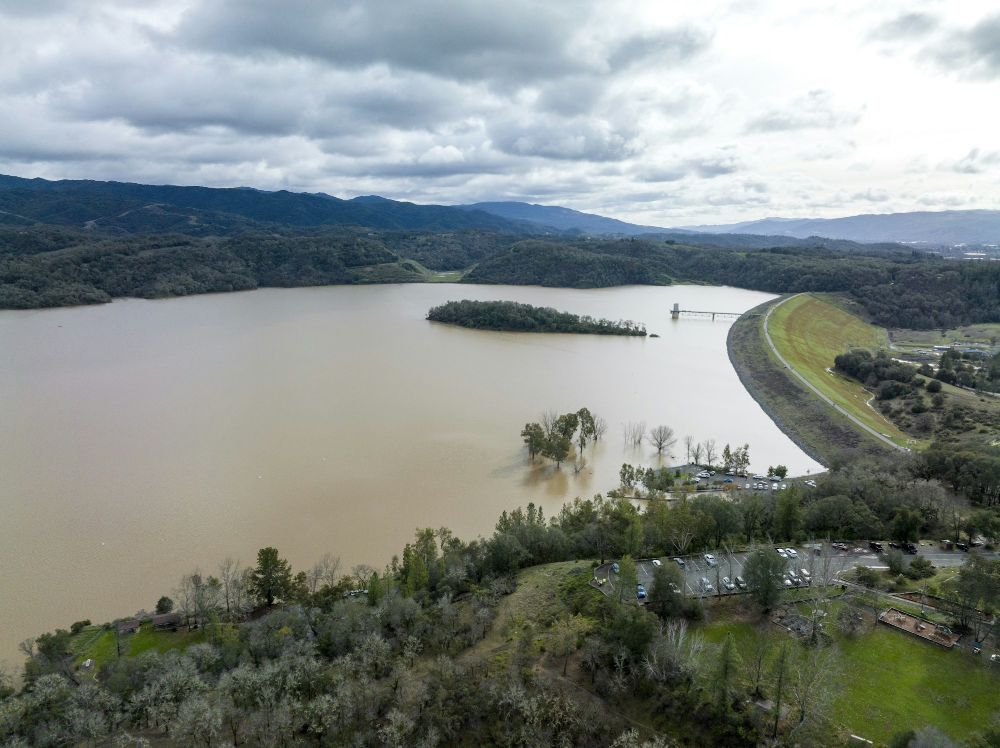
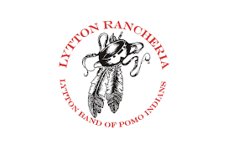

Coyote Valley Dam General Investigation Study February Update
Last Updated: 1/30/2026
USACE Activities
USACE paused study on October 20th. Waiting for additional funding.
Sponsor Activities
IWPC & Lytton exploring opportunities for shared federal messaging and advocacy.
Next CVD Ad Hoc Committee Meeting – February 23rd.
Funding Outlook
Energy & Water Development Appropriations Bill passed and signed by the President on January 23rd.
Includes $7.5M for USACE General Investigations (GI) Workplan.
Lytton requesting a meeting with Assistant Secretary for Army (ASA) of Civil Works (CW) to advocate for USACE Workplan funds.
Lytton looking for other opportunities to influence the administration’s funding priorities.
FY27 President’s Budget:
Presidents Budget is the next opportunity to be identified for funding.
Required by law to be released NLT the 1st Monday in February. No formal penalty for delay.

Slide 2
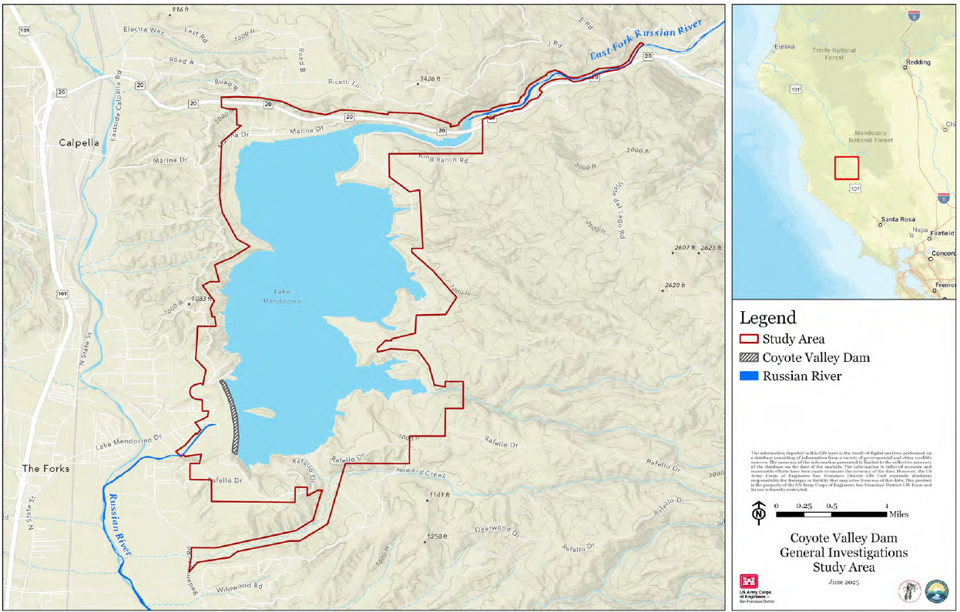
Coyote Valley Dam General Investigation Study Background
Last Updated: 1/30/2026
Study Area
Study authorized by Section 1201(3) of the Water Resources Development Act of 2016 (PL 114-322).
Feasibility Cost Sharing Agreement signed March 31, 2025
MCIWPC and Lytton Rancheria are joint non-Federal sponsors
Includes $658,000 credit for Tribal participation.
Establishes $3,000,000 budget cost-shared 50% Fed / 50% Non-Fed minus Tribal credit.
Local Agreement between MCIWPC and Lytton signed March 19, 2025.
Federal Appropriations History:
FY 2024 = $500,000
FY 2025 = $0
FY 2026 = TBD
Completed Activities:
NEPA interagency kickoff meeting conducted June 26, 2025; additional scoping will resume once additional federal funds are received.
Series of meetings (charettes) held July 2025 to identify study problems and opportunities and begin documenting existing and future conditions.
Coyote Valley Dam site visit occurred August 5, 2025.

