Slide 1
Potter Valley Drought Variance Working Group
Monthly Meeting
Water Management Report
Oct. 30, 2025

Slide 2
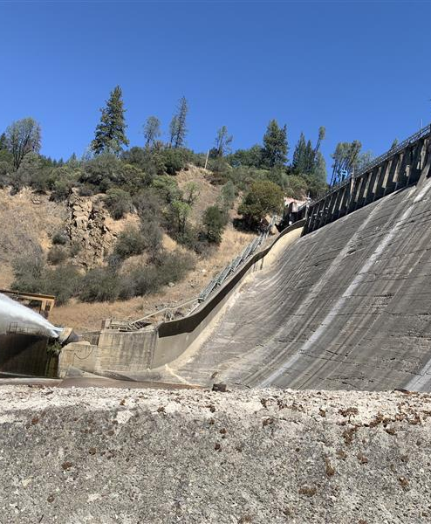

We have a short agenda as follows:
Welcome/Roll Call – Chadwick
Water Management Report- Michelle
Water Temperature Data- Andrew
Discussion/Round Table – All

Slide 3
Meeting Ground Rules
Meeting Ground Rules
Listen
Listen to and Respect Each Other
Act
Act in Good Faith
Open
Open Discussion by All
Seek
Seek Collaborative Solutions
Silence
Silence Your Cellphone
Identify
Identify Yourself with Name and Org when Commenting
Mute
Please Mute your line if not commenting

Slide 4
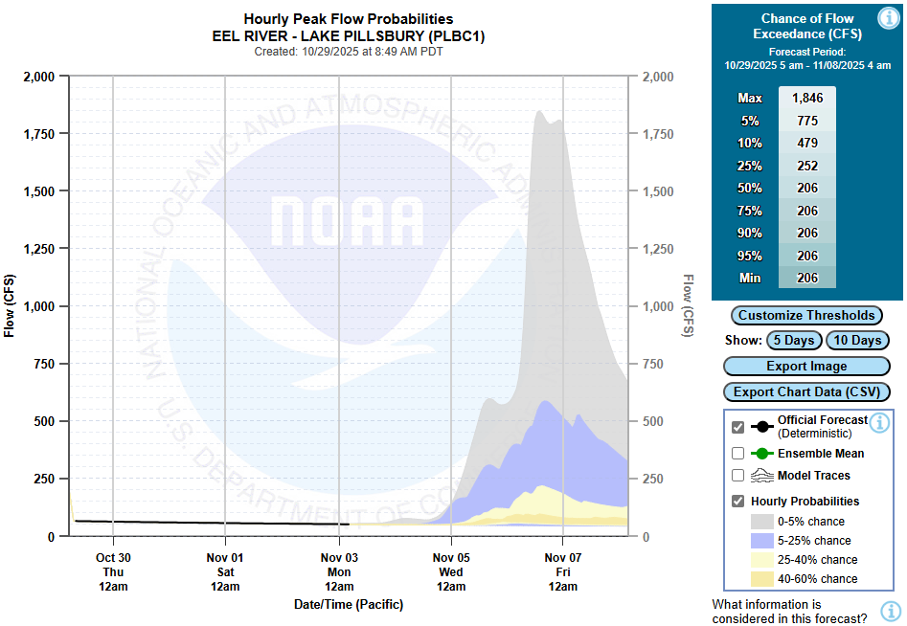
Near-term flow forecast

Slide 5
Pillsbury Storage Forecasts
EBRR flow and Block water release scenarios

Slide 6
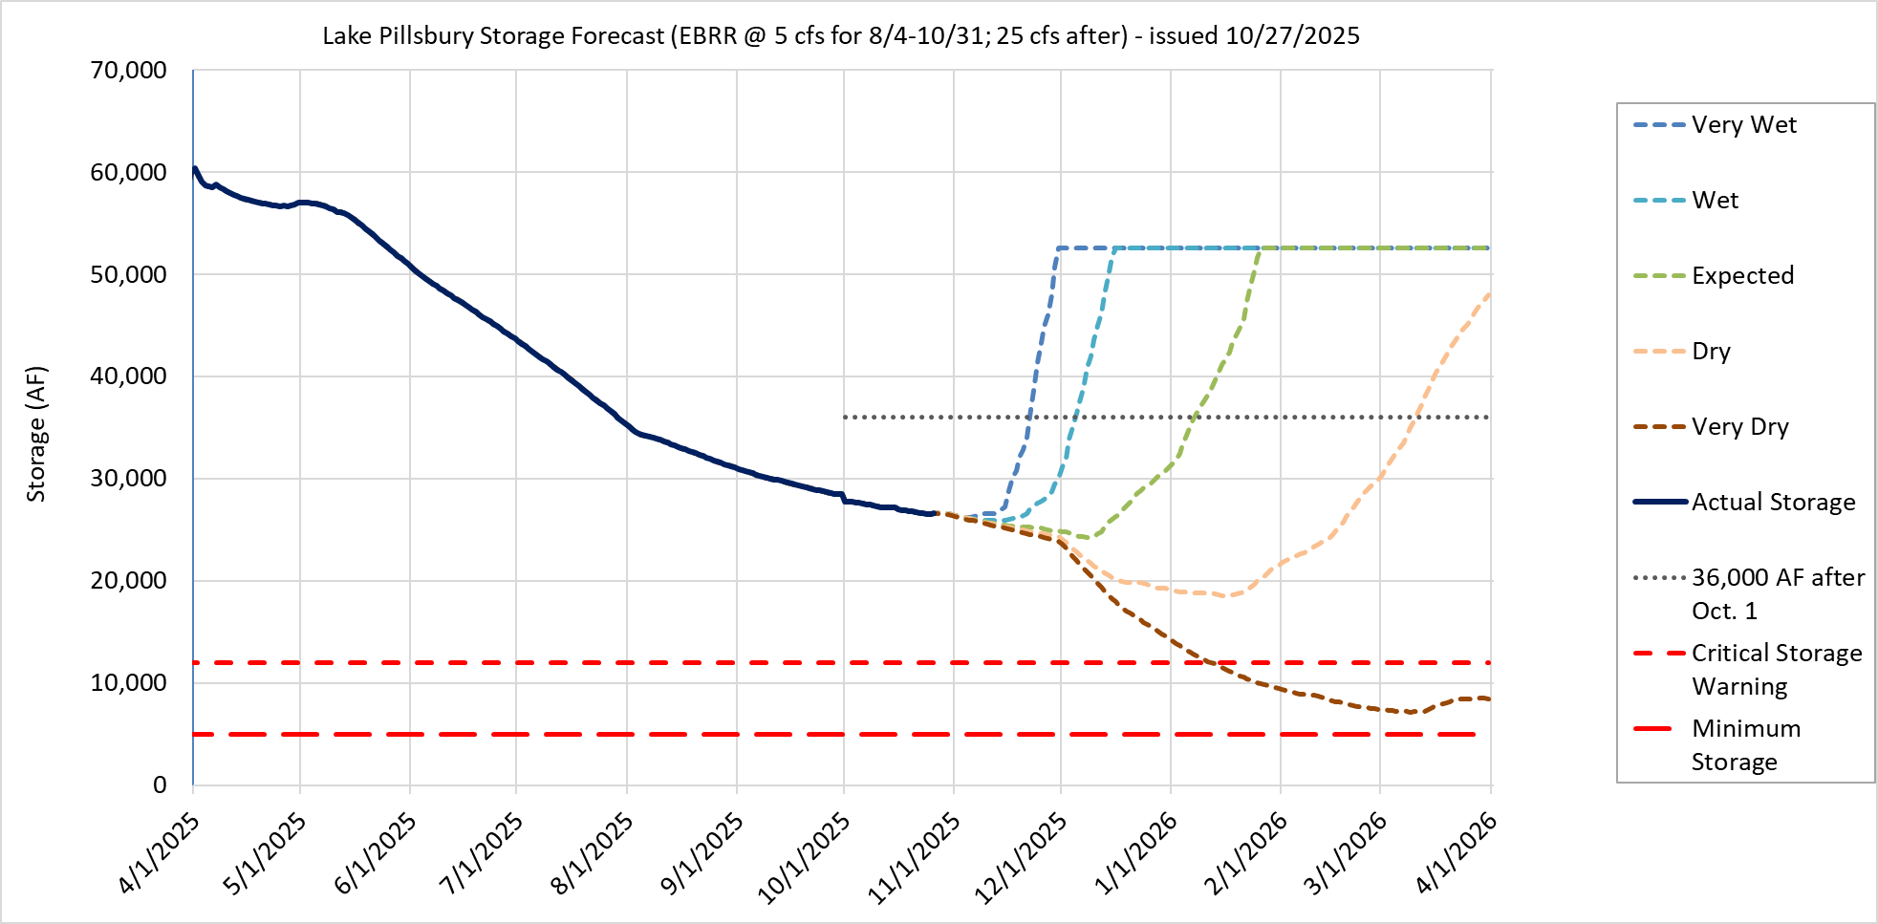
2025/26 Storage Forecast: Nov. 1st EBRR increases to 25 cfs; Dec. 1st BW release
Elevation
1902’
Oct. 30:
1,881.2’
26.5 TAF
1897’
Exit variance
1891’
8/4: Entered variance
(EBRR @ 5 cfs) and set PVID allotment
1883’
10/1: Updated elev-cap table
11/1: EBRR increase to 25 cfs
1875’
12/1: Block water start (2.5 TAF)
1861’
Assumptions: EBRR @ 5 cfs until Sept. 30th, then 25 cfs for remainder of variance; Block water release: 2.5 TAF starting Dec. 1st; Post-Oct. 1st, Variance ends >36 TAF

Slide 7

2025/26 Storage Forecast: EBRR remains at 5 cfs; Dec. 1st BW release
Elevation
1902’
Oct. 30:
1,881.2’
26.5 TAF
1897’
Exit variance
1891’
8/4: Entered variance
(EBRR @ 5 cfs) and set PVID allotment
1883’
10/1: Updated elev-cap table
1875’
12/1: Block water start (2.5 TAF)
1861’
Assumptions: EBRR @ 5 cfs for remainder of variance; Block water release: 2.5 TAF starting Dec. 1st; Post-Oct. 1st, Variance ends >36 TAF

Slide 8

2025/26 Storage Forecast: Nov. 1st EBRR increases to 25 cfs; No BW release
Elevation
1902’
Oct. 30:
1,881.2’
26.5 TAF
1897’
Exit variance
1891’
8/4: Entered variance
(EBRR @ 5 cfs) and set PVID allotment
1883’
10/1: Updated elev-cap table
11/1: EBRR increase to 25 cfs
1875’
1861’
Assumptions: EBRR @ 5 cfs until Sept. 30th, then 25 cfs for remainder of variance; No December Block water release; Post-Oct. 1st, Variance ends >36 TAF

Slide 9

2025/26 Storage Forecast: EBRR remains at 5 cfs; No BW release
Elevation
1902’
Oct. 30:
1,881.2’
26.5 TAF
1897’
Exit variance
1891’
8/4: Entered variance
(EBRR @ 5 cfs) and set PVID allotment
1883’
10/1: Updated elev-cap table
1875’
1861’
Assumptions: EBRR @ 5 cfs for remainder of variance; No December Block water release; Post-Oct. 1st, Variance ends >36 TAF

Slide 10
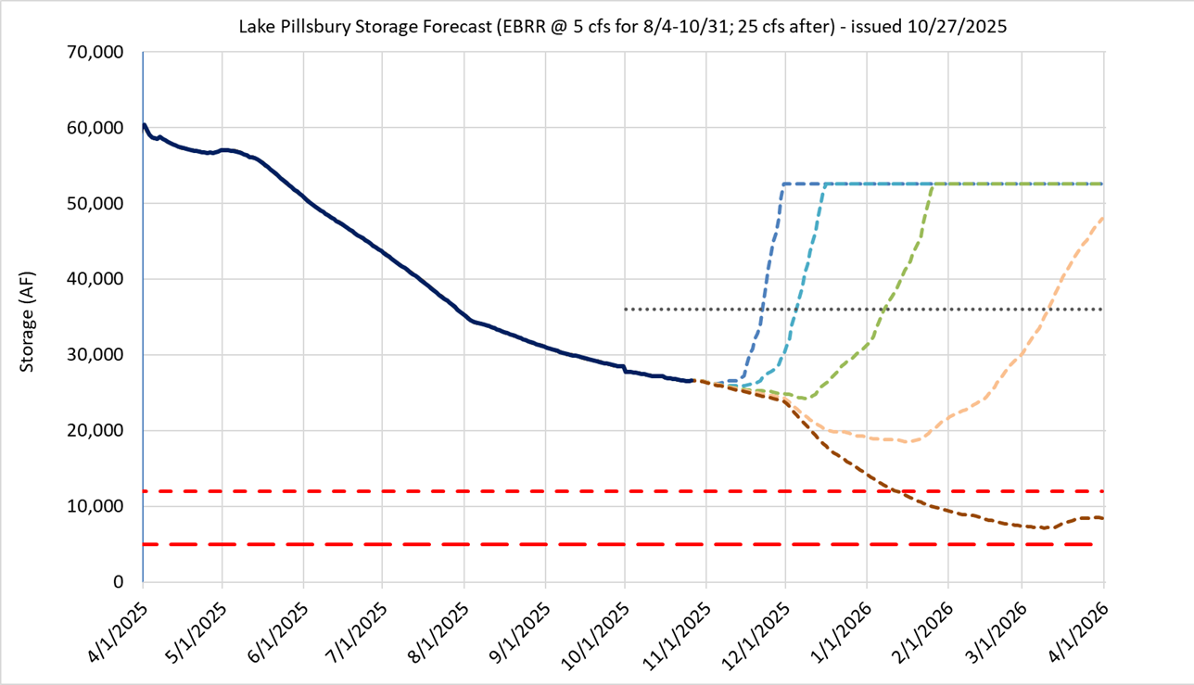
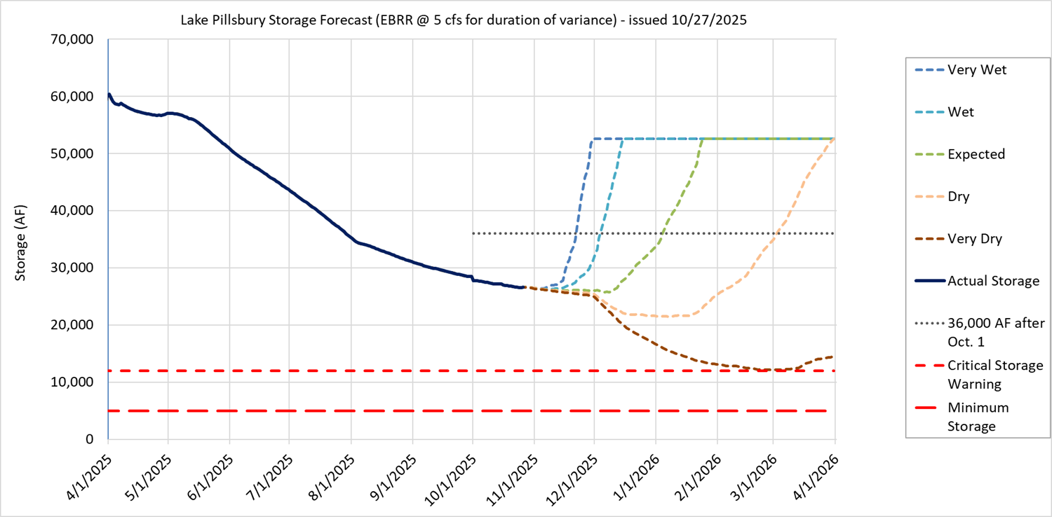
Scenario Comparison
EBBR after 10/31?
Increase to 25 cfs
Remain at 5 cfs
Y
Block Water?
N

Slide 11
Aug. 2025 - Storage and Flow (Preliminary Data)
Variance was approved Aug. 4th and was implemented that same day
PVID’s allotment is 3,570 AF for the remainder of the irrigation season. This corresponds to 25 cfs average for Aug. 5th to Oct. 15th.

Slide 12
Sep. 2025 - Storage and Flow (Preliminary Data)

Slide 13
Oct. 2025 - Storage and Flow (Preliminary Data)
Note: Going into W2026, the Lake Pillsbury elevation-capacity table was updated with 2023 bathymetry.
PVID used approximately 3,134 AF out of their 3,570 AF allotment for the Aug. 5th to Oct. 15th period of the irrigation season. This corresponds to 22 cfs average for the period following variance implementation.

Slide 14
Water Temperature Data

Slide 15
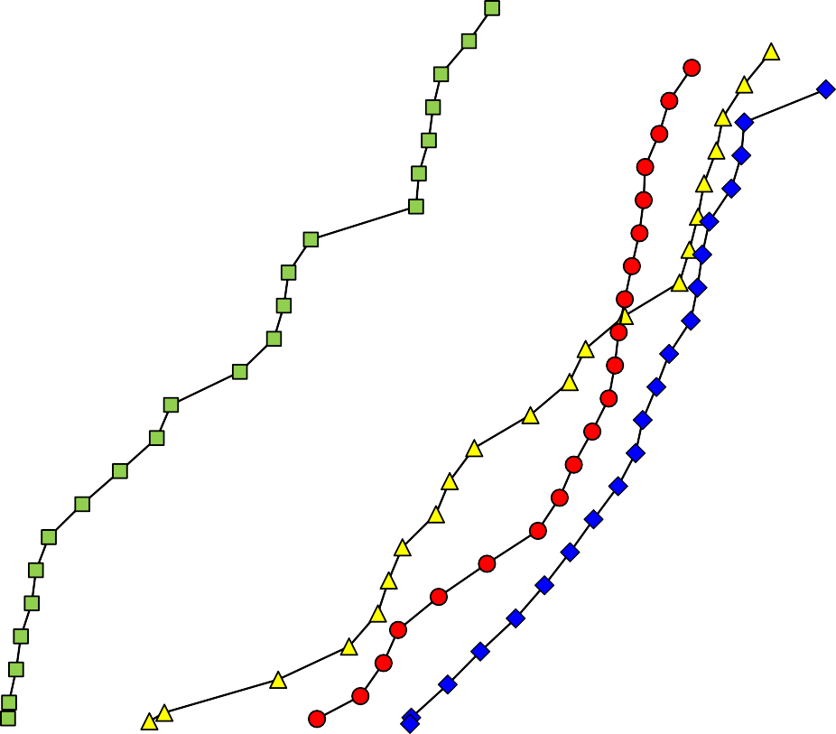

Lake Pillsbury Water Temperature Profile - 2025
1915
1905
5/16/25
06/12/25
06/25/25
07/09/25
07/23/25
08/07/25
08/19/25
09/02/25
09/19/25
Spill Crest - Closed
Spill Crest - Open Needle Valve Intake
1895
1885
Elevation (ft amsl)
1875
1865
1855
1845
1835
1825
1815
0
2
4
6
8
10
12 14 16 18
Water Temperature (ºC)
20
22
24
26
28
30

Slide 16
Figure 1. Mainstem Eel River water temperatures, 2025, Eel River above Benmore Creek
Recorder ID: Combo 20291807 MWAT [1]: 22.8°C
30
MAX
MEAN MIN
25
Temperature, Degrees C
20
15
10
M A Y
J U N
J U L
A U G
S E P
O C T
graph_table_2025_Trout and Benmore

Slide 17
Figure 2. Mainstem Eel River water temperatures, 2025, Eel River above Trout Creek
Recorder ID: Combo 20401446 MWAT [1]: 23.6°C
30
MAX
MEAN MIN
25
Temperature, Degrees C
20
15
10
M A Y
J U N
J U L
A U G
S E P
O C T
graph_table_2025_Trout and Benmore

Slide 18
Figure 3. Difference between Mainstem Eel River daily maximum, mean and minimum water temperatures at Benmore Creek (river mile 166.4) and Trout Creek (river mile 160.8), 2025 WY.
5
Values are the differences between the maximum, minimum, and mean daily water temperatures at Benmore Creek and Trout Creek, reflecting the change in temperatures from Benmore Creek (river mile 166.4) to the temperatures in the Eel River above Trout Creek (river mile 160.8).
Max
Min Mean
4
3
Temperature, Degrees C
2
1
0
-1
-2
M A Y
J U N
J U L
A U G
S E P
O C T
Variance Temp Data 2025_Eel River Diffs between Benmore and Trout Creek

Slide 19
Round Table

